Slide 1



Slide 2


Programme Name : B. Tech Information Technology (B.Tech. IT) Offered By : Department of Information Technology Faculty of Technology, Marwadi University Presentation By : Prof Tarannum Bloch ( PhD pursuing, M. Tech(IT), B.E.(IT), D.E.(IT)) Assistant Professor Faculty of Technology, Marwadi University

Slide 3
Agenda
Introduction to IT Department
Department level Student Centric Activities
Women Cell
MU Fest
Industry Interaction

Slide 4
Introduction to Department
The Department of IT Engineering, Marwadi University seeks to combine excellence in education and research with service to the industry. Our vision is to be recognized as an innovative and leading Information Technology Department in India and beyond.
The Information Technology and Management programme applies a hands-on, reality-based approach to education that allows students to apply what they learn in class to solve real-life problems.
Our teaching philosophy, project-based learning, and knowledge retention process prepare students to become innovators, entrepreneurs, and leaders of the future.

Slide 5
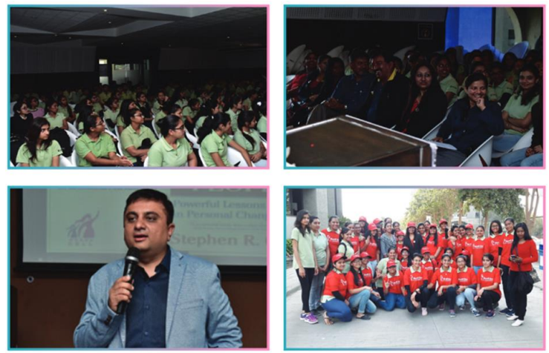
Department level Student Centric Activities
Glimpse of Run for Nine Event

Slide 6
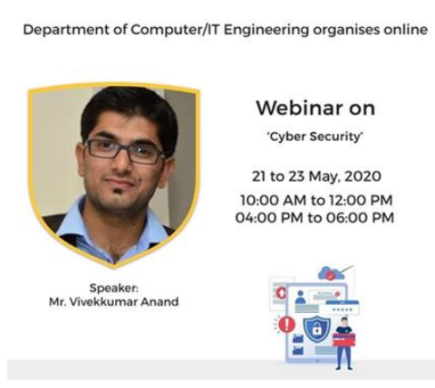
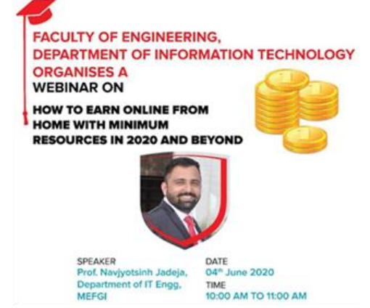
Department level Student Centric Activities
Webinars by Expert Faculty

Slide 7
Technical Clubs
Google cloud Career Readiness Program
Oracle academy
CISCO Academy
ICT Academy
IEEE Student Brach
MUIIR

Slide 8
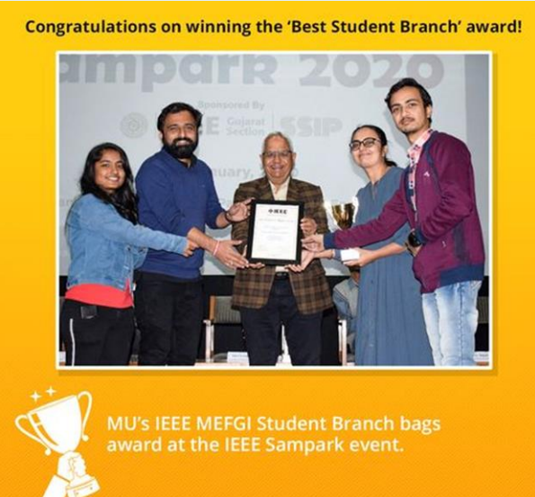
Department level Student Centric Activities
IEEE Best Branch Award Received by Prof. Navjoytsinh Jadeja & Prof. Priyanka Buch

Slide 9
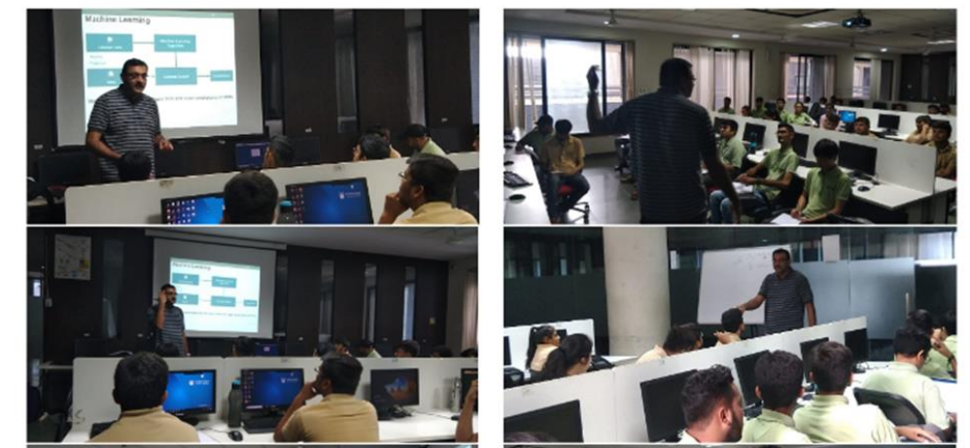
Technical Event
Glimpse of Workshop on Internet of Things

Slide 10
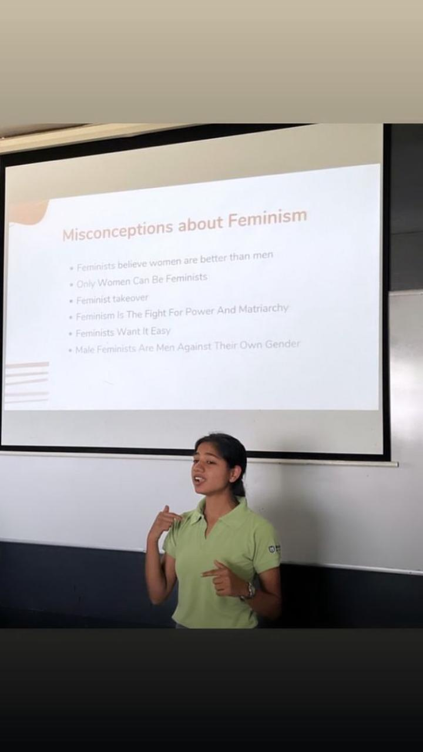
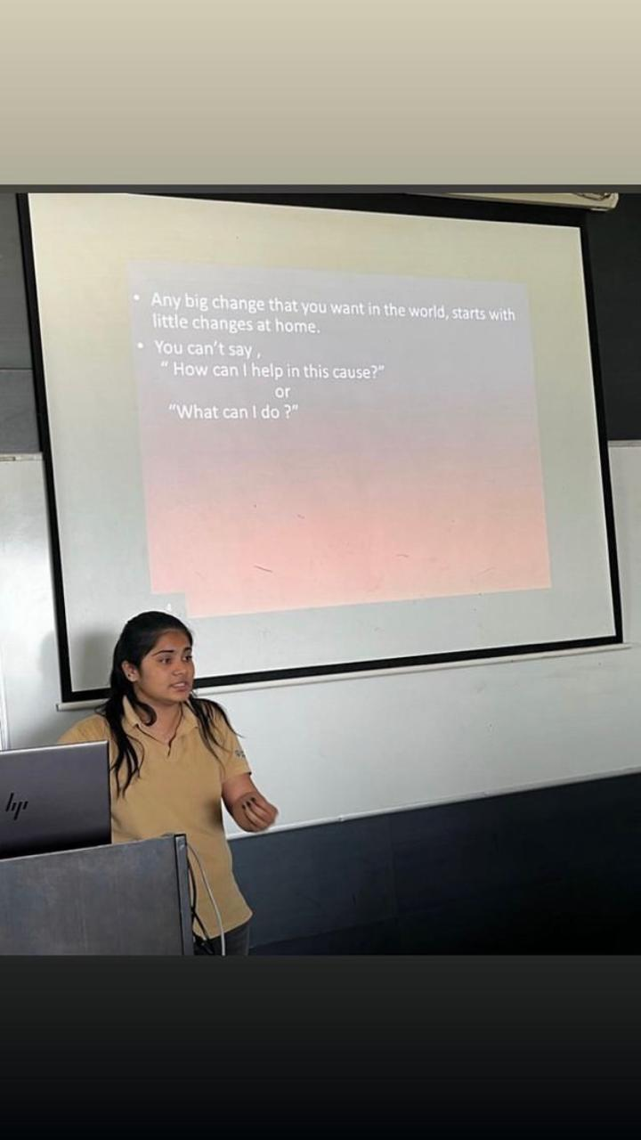
Technical Event
Glimpse of MU Hatch Pitch

Slide 11
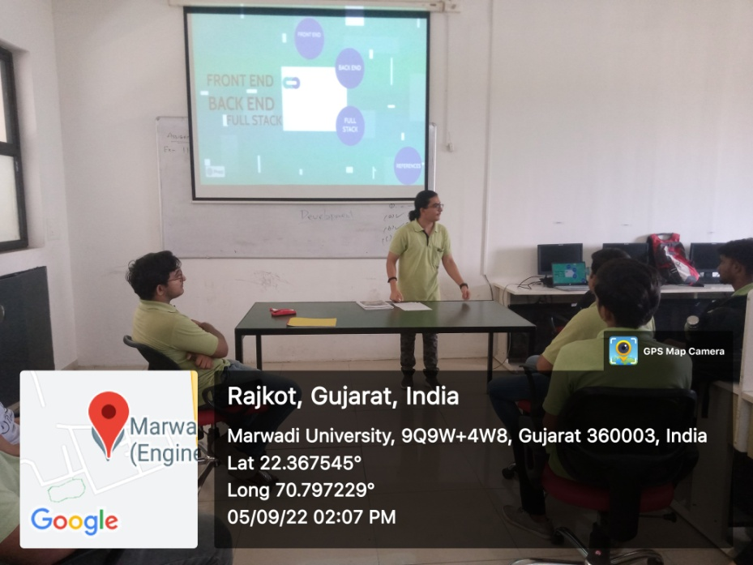
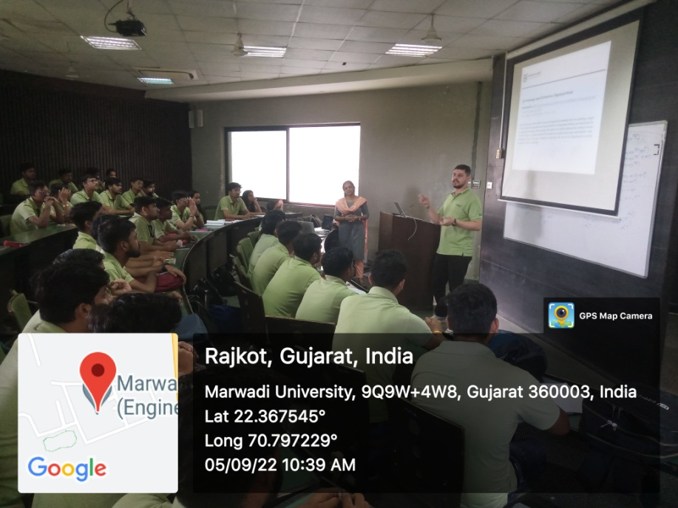
Technical Event
Glimpse of Peer learning

Slide 12
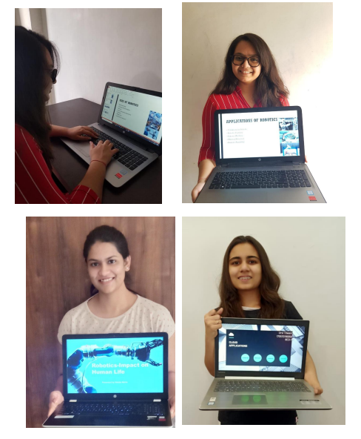
Technical Skill improvement Activities

Slide 13
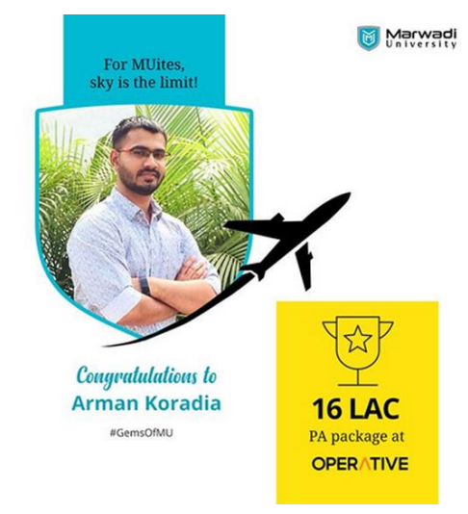
IT Department Student Achievement

Slide 14
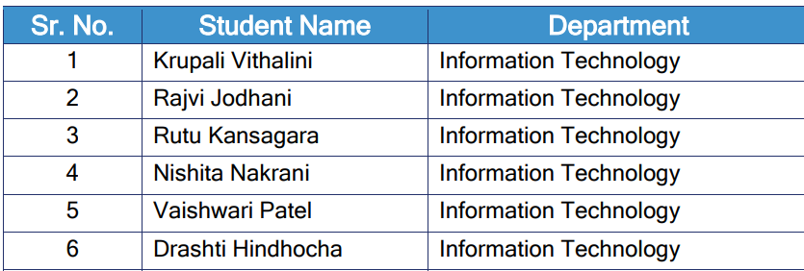
Student Exchange Programme
Technical University of Kaiserslautern, Germany (1-5)
University of Pitesti – Romania (6)

Slide 15
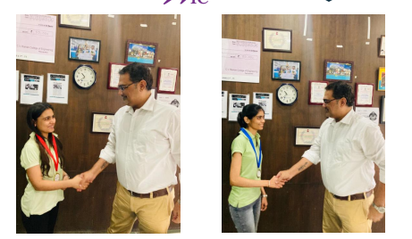
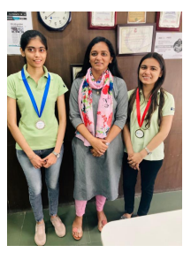
Students Achievements

Slide 16
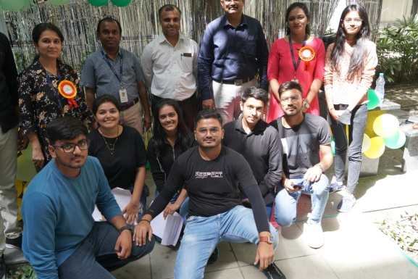
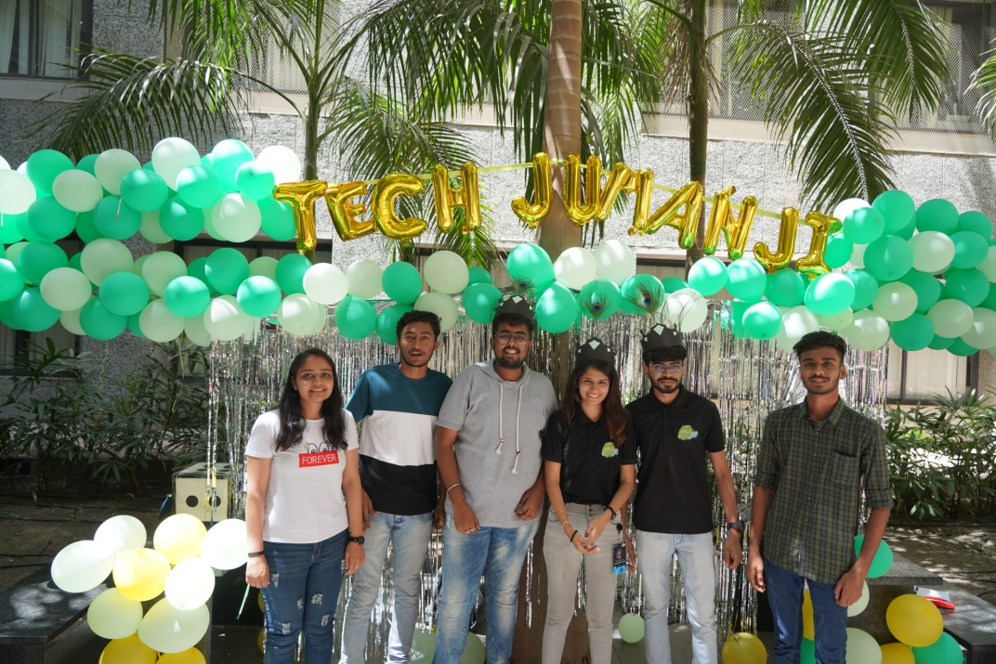
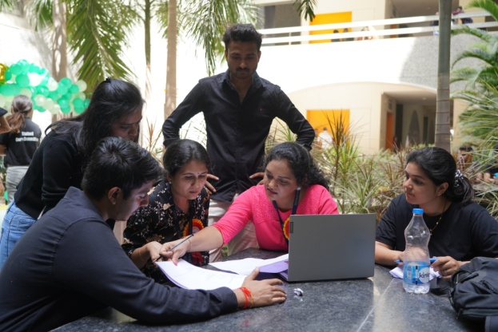
MU Fest

Slide 17
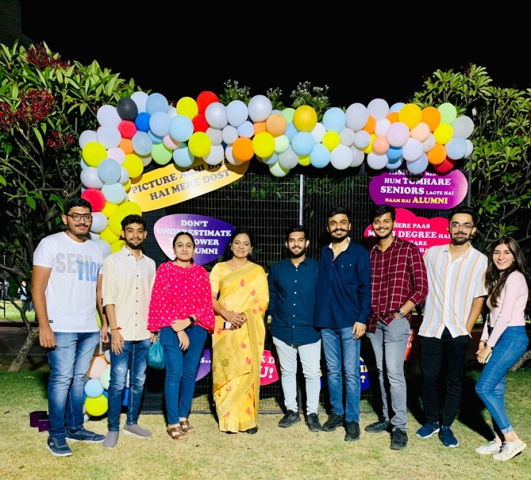
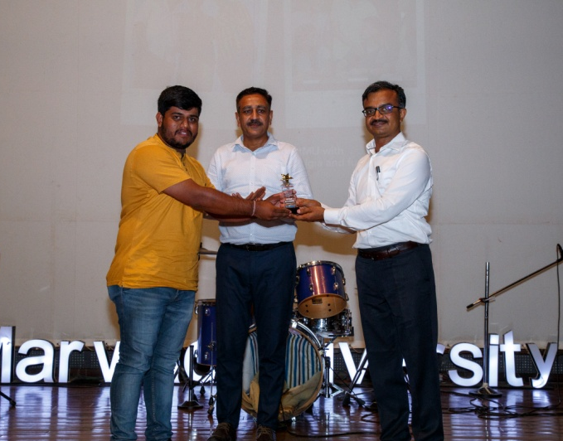
Alumni Connect

Slide 18
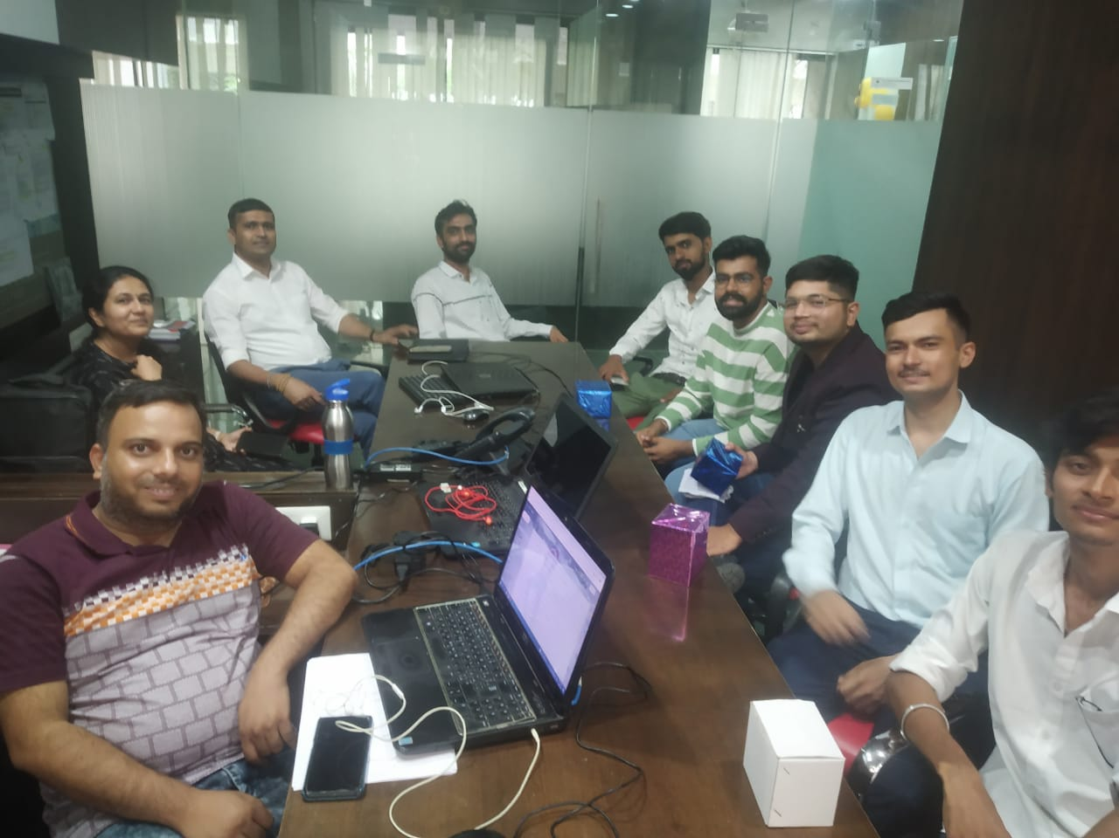
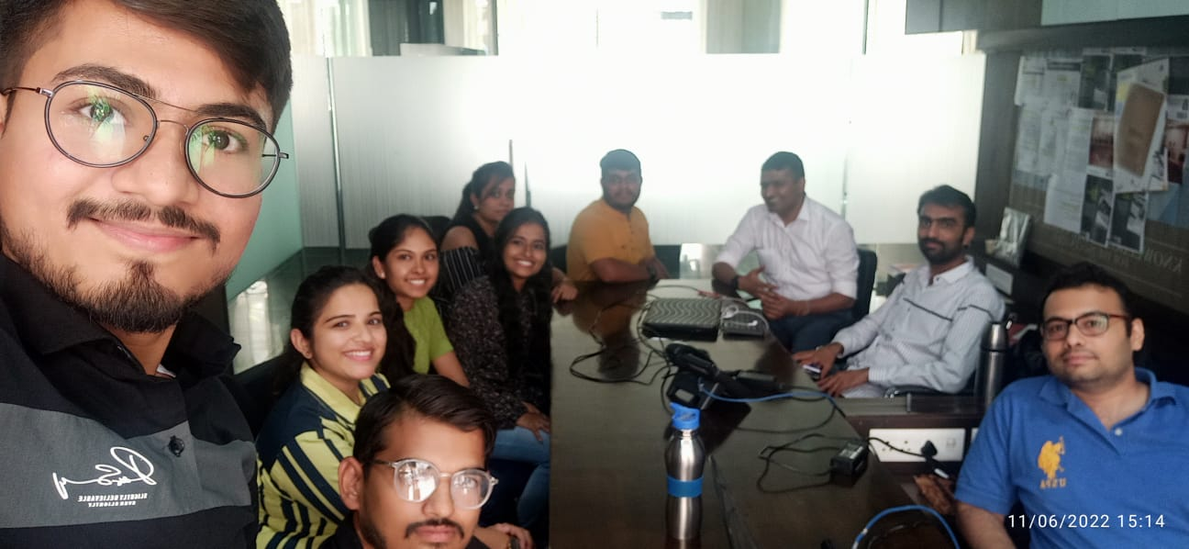
Alumni Connect

Slide 19
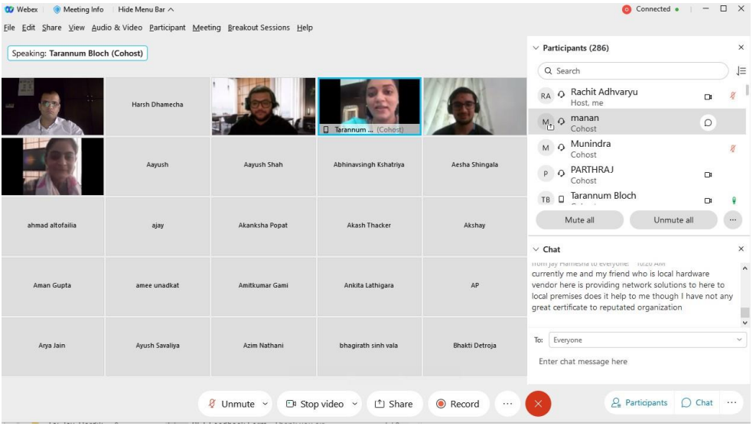
Alumni Connect

Slide 20
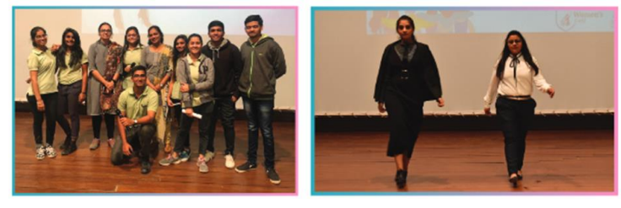
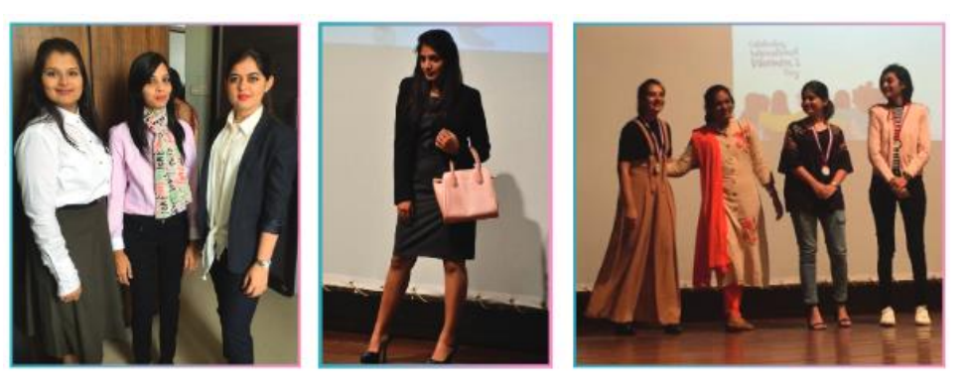
Glimpse of Women Cell Event– Office Attire Fashion Show

Slide 21
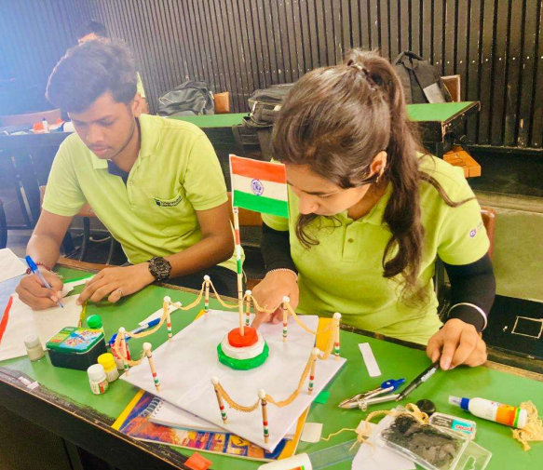
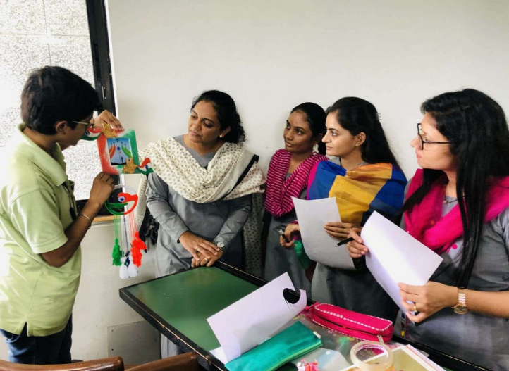
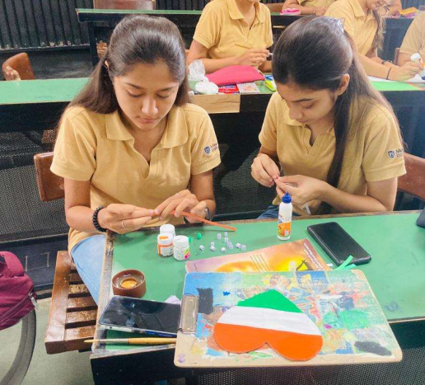
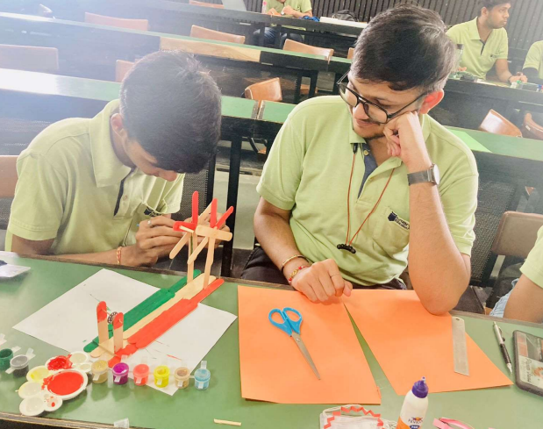
Extra curricular Activities

Slide 22
THANK YOU

